Slide 1
CS 370 Introduction to Security
Secure Socket Layer (SSL) and
Transport Layer Security (TLS)
Yeongjin Jang

Slide 2
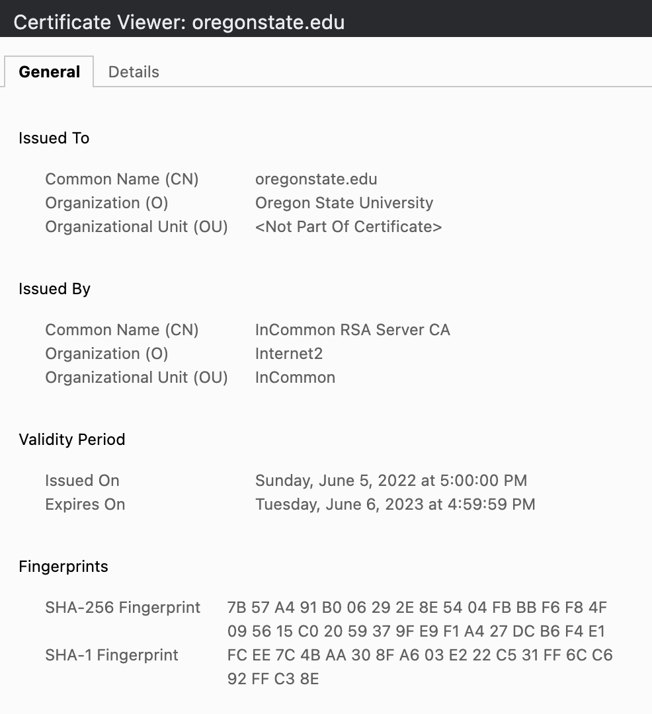
Digital Certificate
A file that contains
Entity info (CN)
Issuer info (CN)
Public key
Signature

Slide 3
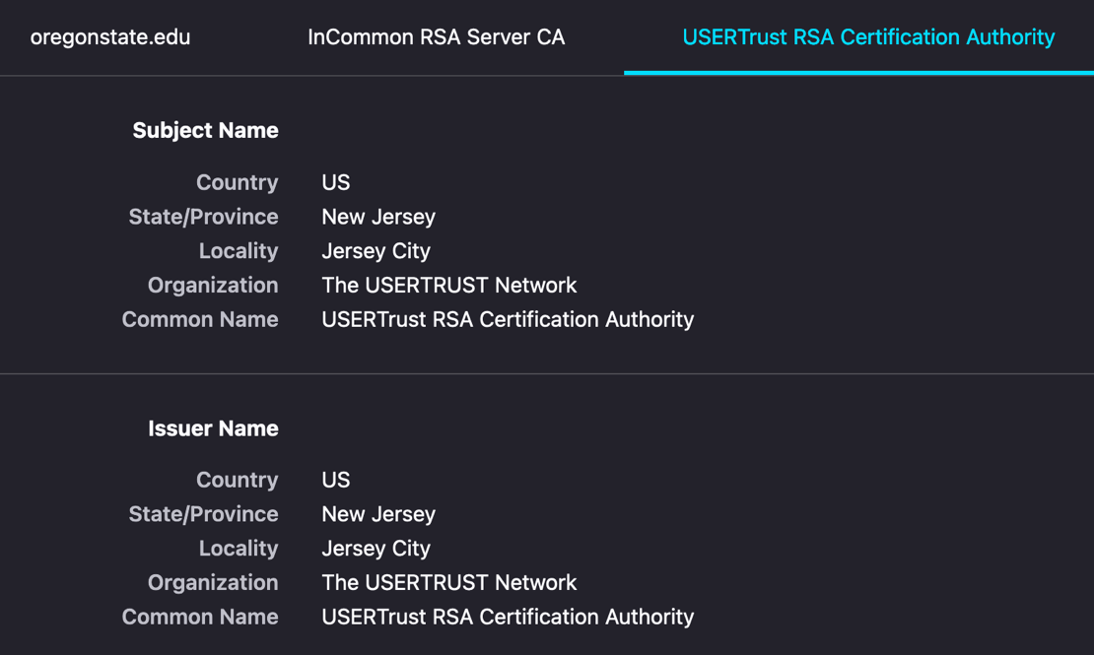
Trust Chain
oregonstate.edu
Verified by InCommon RSA Server CA
InCommon RSA Server CA
Verified by USERTrust RSA Certificate Authority
USERTrust RSA CA
Verified by itself

Slide 4
Public Key Infrastructure (PKI)
An Infrastructure that provides public key with certificate chain
Trust anchor: Root CA
We set a small set of entities use self-signed cert
Verify the certificate chain!
We must verify the entire chain
USERTrust
InCommon
oregonstate

Slide 5
Diffie-Hellman Key Exchange
User A & User B agrees on g and p, where g and p are primes
User A secretly chooses a, send A = gª mod p
User B secretly chooses b, send B = g^{b} mod p
User A receives B, compute Bª = (g^{b})ª mod p = g^{ab} mod p
User B receives A, compute A^{b} = (gª)^{b} mod p = g^{ab} mod p
g^{ab} mod p is our secret

Slide 6
Diffie-Hellman Key Exchange
g^{ab} mod p is our secret
Attacker knows g, p, A = gª mod p and B = g^{b} mod p
A+B = (gª + g^{b}) mod p
AB = g^{(a+b)} mod p
Hard to compute g^{ab} from those values
Discrete logarithm; Can you get a from A = gª mod p

Slide 7
How Can We Secure the Internet Communication?
Authentication
Get the certificate of each entity
Verify their public key
Using certificate trust chain!
Key-exchange
A computes gª mod p, and sign that with A’s private key
B computes g^{b} mod p, and sign that with B’s private key
Both can verify the identity of each and then share
g^{ab} mod p
Killed
Man-in-the-middle attack!

Slide 8


How Can We Secure the Internet Communication?
Confidentiality
Run SHA-256(‘cipher key’ + g^{ab} mod p)
Use that as the key for the block cipher
E.g., AES-256-CBC
Integrity
Run SHA-256(‘mac key’ + g^{ab} mod p)
Use that as the key for HMAC
IV
Ciphertext with padding
HMAC
A communication channel with
Authenticity
Confidentiality
Integrity
has been established!

Slide 9
Topics for Today
The Insecure Internet
OSI 7 layers, no security at all
Secure Socket Layer
Enabling secure communication over the Internet
Later, the name changed to Transport Layer Security
We will learn how SSL/TLS establishes secure communication channel
Over the insecure Internet!

Slide 10
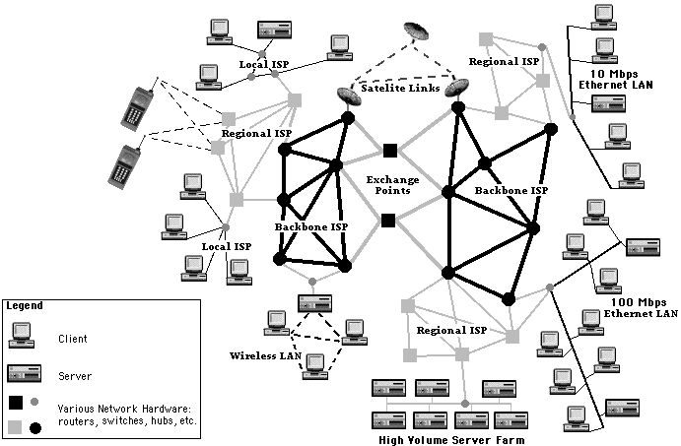
Internet
Inter + net
A network of networks
Design principle
Network is complex, O(N²)
Manage small network, O(n²)
Manage network of networks O(m²)
N >>>>> m,n
Make it simple
Image is from: https://www.cs.utexas.edu/~mitra/csFall2018/cs329/lectures/fig1.gif

Slide 11
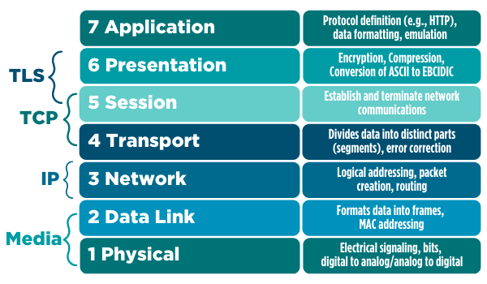
OSI layer
Abstraction layer for computer network
No security at all
Before TLS/SSL kicks in
Image is from:
https://comptiacdn.azureedge.net/webcontent/images/default-source/blogs/osi-rm-4.png

Slide 12

How is a Packet Routed?
you
me

Slide 13
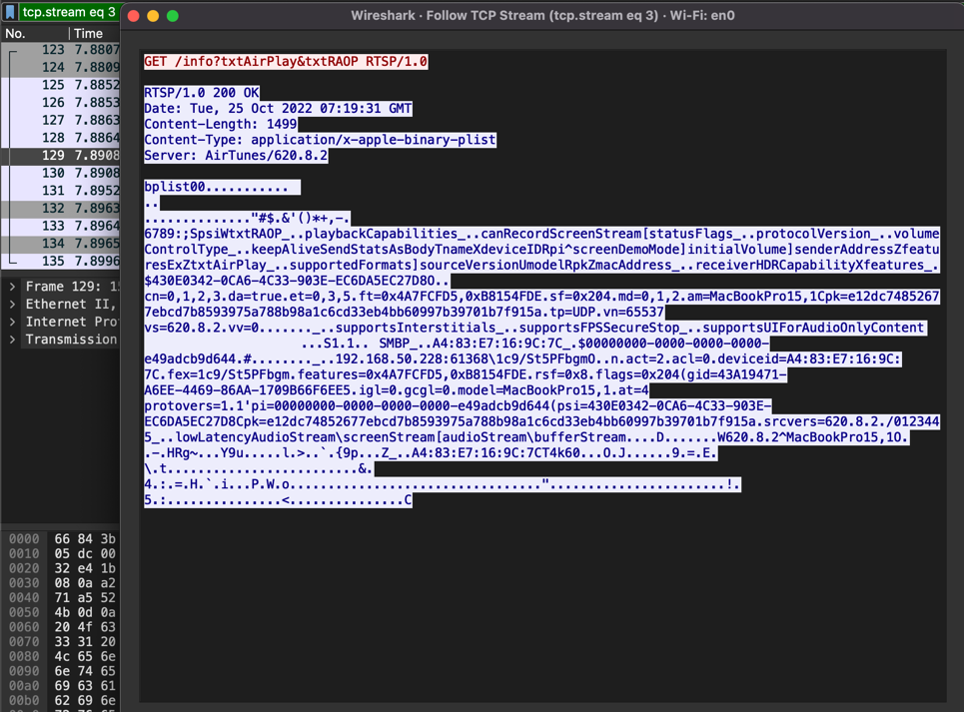
TCP Communication
Totally insecure
Any router in the middle can see your packet content!!

Slide 14
How Can We Trust Routers (in the middle)?
you
me

Slide 15

Router Decides Where the Packet Should Go as a Next Step
What if the router in the middle send the packet to
Weird location???
This is totally possible
Yes, router will check the IP but
What if routers are malicious???
There is no restriction in doing such..
you
me
15

Slide 16

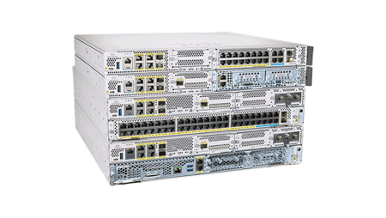
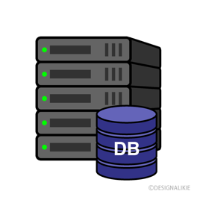

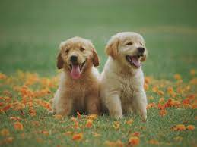
The Internet w/o SSL/TLS
Search “Dog”
Everybody in the middle knows that I searched ‘dogs’ and
they also know the search result…

Slide 17

The Internet with SSL/TLS
Middle mans never know
DH exchange keys!!
Check certificate, exchange keys, apply encryption with HMAC
I know these two are communicating but not about the secret key…
Search “Dog”
Search “Dog”
0x1ce42780dfa1cea089a9ea00de059ef5
The middlemen will only see the encrypted contents
They will never know the secret key

Slide 18
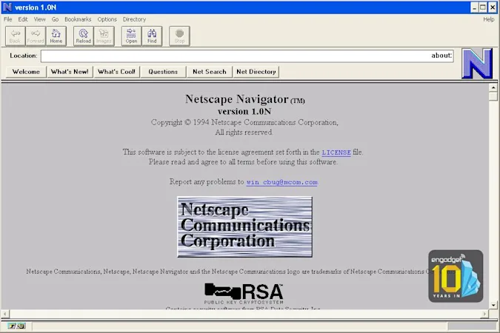
Secure Socket Layer and Transport Layer Security
Developed by Netscape in 1995..
The Internet is insecure, as a web browser, we need a way to communicate securely!
Later, standardized by IETF as Transport Layer Security
https://www.ietf.org/rfc/rfc2246.txt

Slide 19
Why Transport Layer Security?
OSI Model

Slide 20
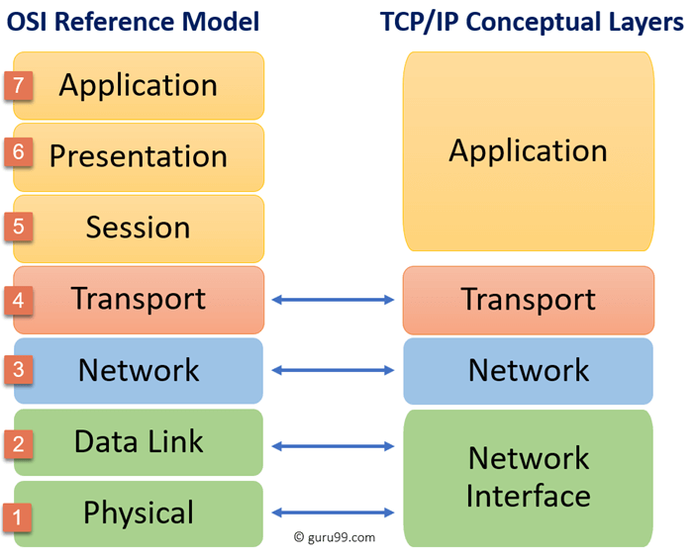
Why Transport Layer Security?
OSI vs IP Layers
TLS would like to be
Transparent to applications
If transparent,
Applications does not have to change
their behavior for adopting
security to the network protocols

Slide 21
What an SSL/TLS can do?
Establish a secure communication channel between
Two ends on the Internet
Client/Server
Server/Server
Client/Client
We usually use this to verify the server entity
You will be authenticated by the server via login interface..

Slide 22
What an SSL/TLS can do?
End-to-end secure communication channel
Authenticity (Who are at each ends?)
Secure key exchange (Nobody else than those two know the key!!)
Confidentiality (No one else than those two can see the message)
Integrity (We know if the message is altered)

Slide 23
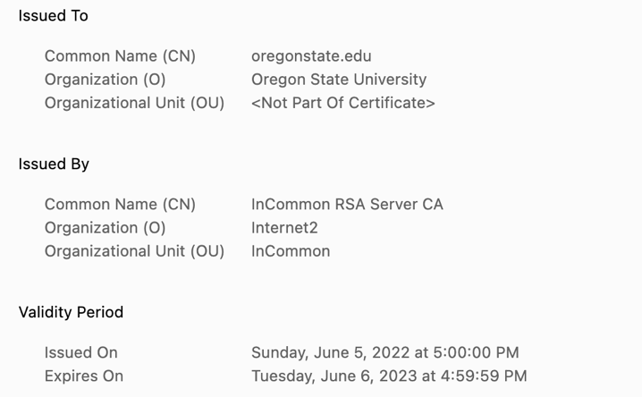
SSL/TLS Steps
Authenticity
We usually use SSL/TLS to verify the server identity
E.g., is the server www.oregonstate.edu? Or www.google.com?
We do this by checking the digital certificate
SSL/TLS verifies if the server has PKI-certified digital certificate with the same domain name

Slide 24
SSL/TLS Steps
Client
1. Client hello
Send version, random number, available cipher suite, etc..
Server
2. Server hello
Sends server random, version, choose cipher, etc.
3. Server Certificate
Send certificate to the client

Slide 25
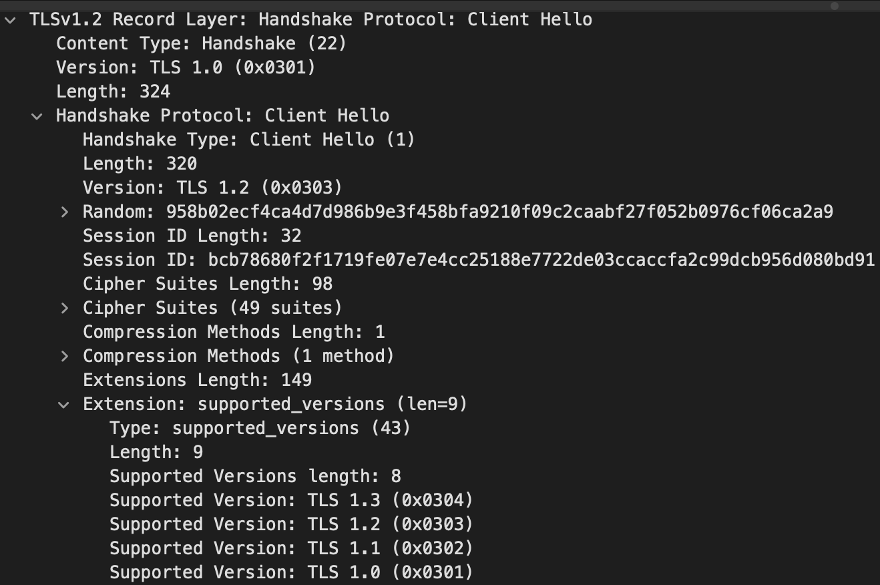
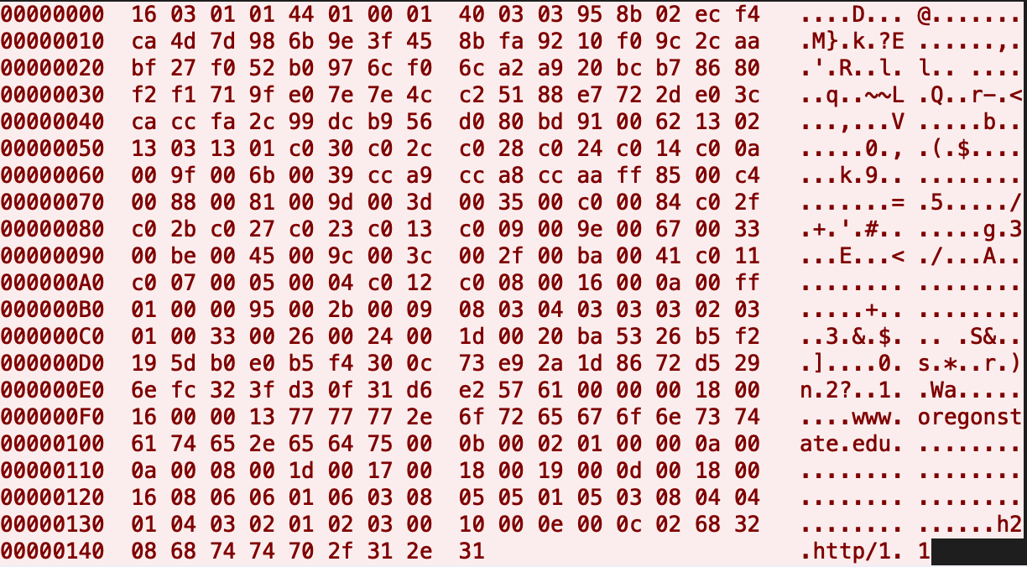
1. Client Hello
The first message that client sends to the server
Sends SSL/TLS version, random number, available cipher suite, etc.

Slide 26
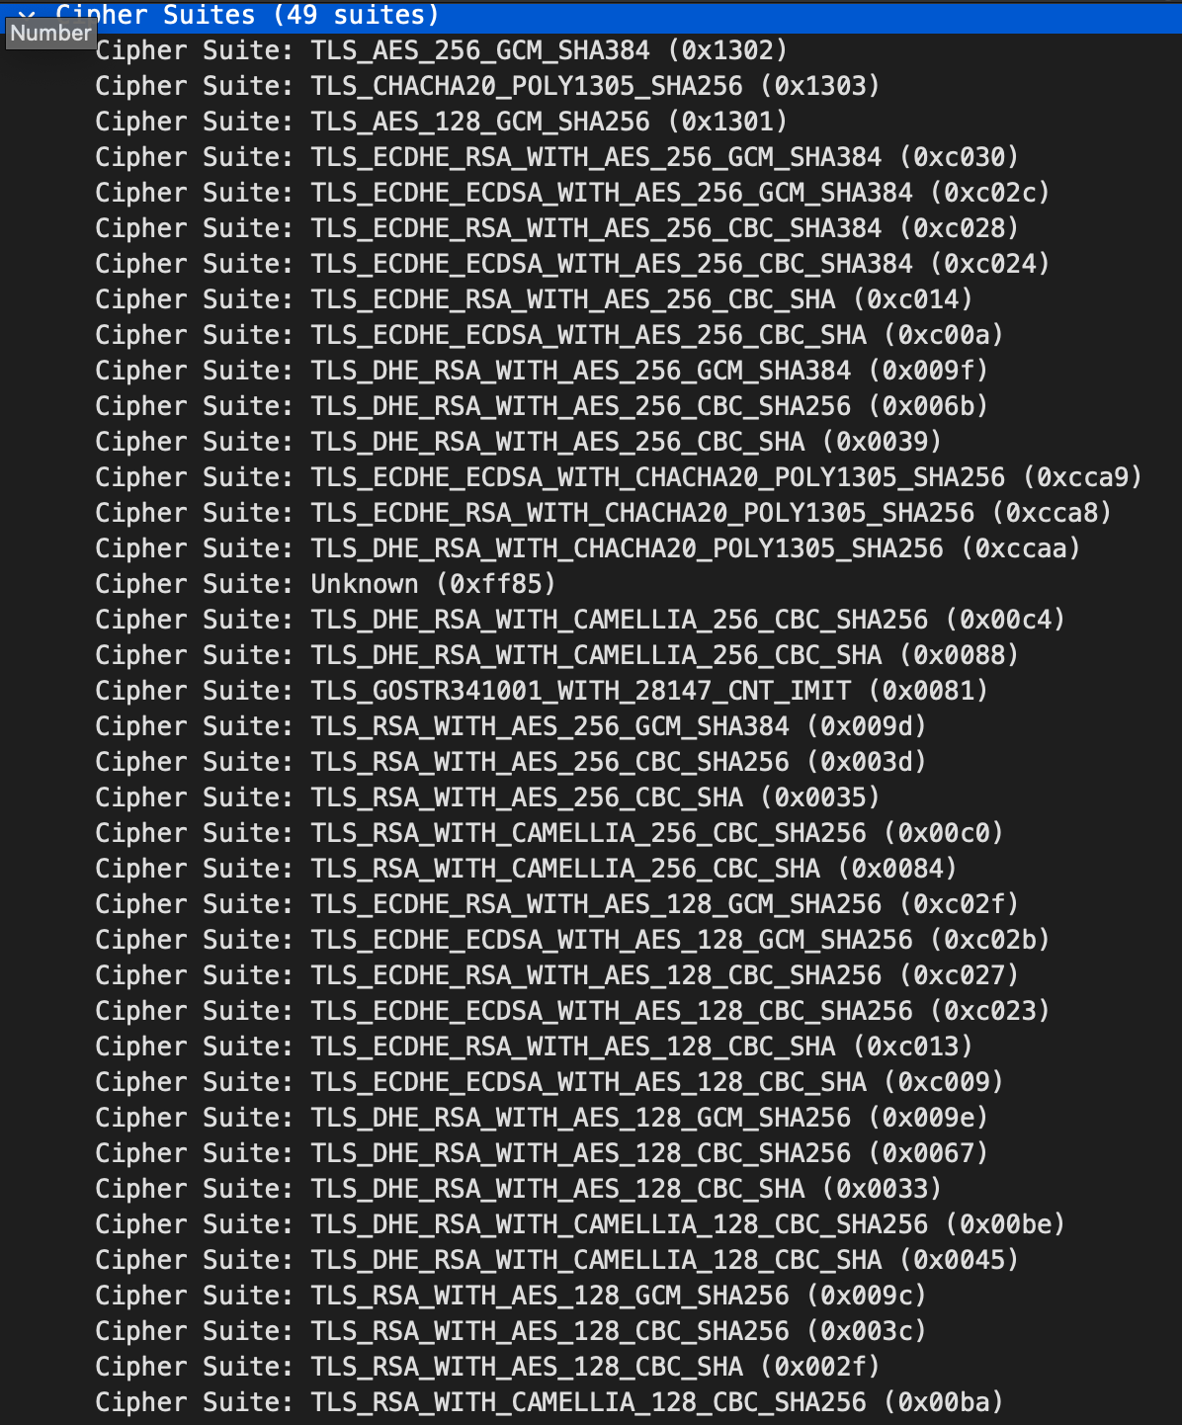
1. Client Hello
Send supported Cipher Suites
TLS_ECDHE_RSA_WITH
AES_128_GCM_SHA256
ECDHE_RSA_AES_128_GCM_SHA256

Slide 27
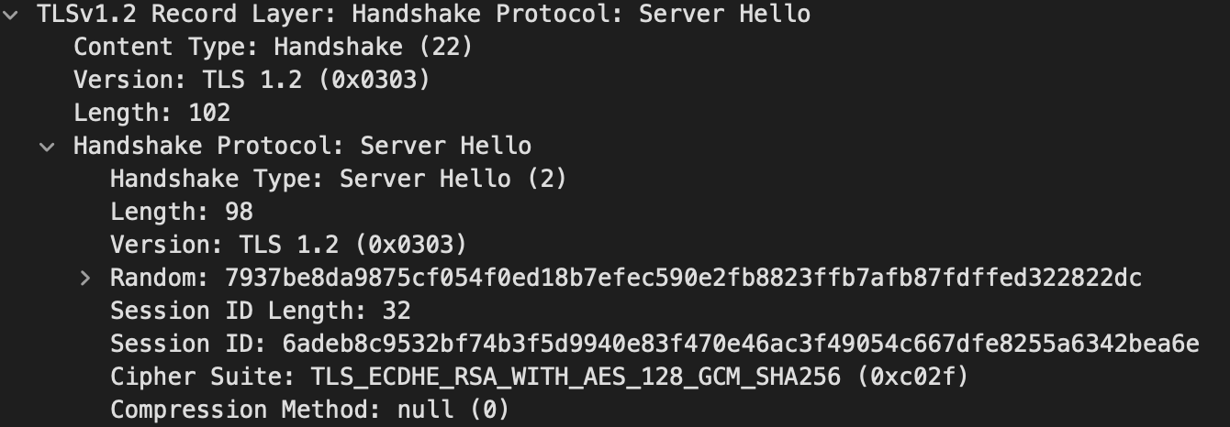
2. Server Hello
The first message that the server sends back to the client
Sends SSL/TLS version, random number, choose cipher suite
ECDHE_RSA_AES_128_GCM_SHA256
The server chose this cipher from client’s availability

Slide 28
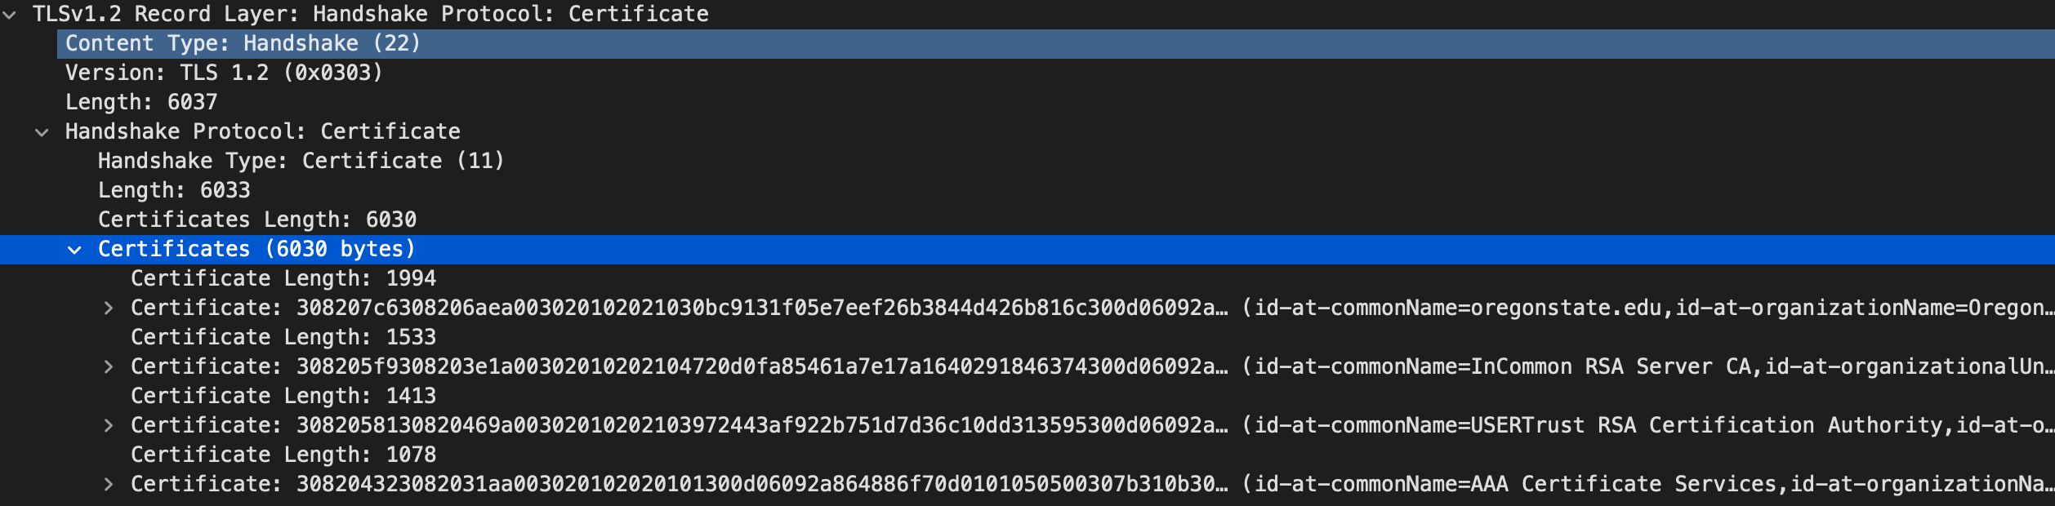
3. Server Certificate
The server sends the certificate information to the client
They send a full chain (PKI) of digital certificates

Slide 29
Key Exchange / Verifying Signature
Previously, client chooses a key and send an encrypted key to server
1) The client knows the server’s public key written in the certificate
2) The client chooses a random key and
3) encrypt that with the server’s public key and
4) send that to the server
Only the server can decrypt the key, so it’s OK

Slide 30
SSL/TLS Steps
Previously, client chooses a key and send an encrypted key to server
Only the server can decrypt the key, so it’s OK
Suppose the server’s private key has been stolen in 3 years later
An attacker has encrypted packet capture
Can they decrypt the data?
YES
They know the private key
They can decrypt the secret key
They can decrypt all the messages
This scheme does not guarantee
Forward Secrecy

Slide 31

What is Forward Secrecy?
Forward Secrecy / Perfect Forward Secrecy
Even if the long-term key (e.g., server’s private key) has been compromised
Can we keep all the old communication secure?
Software/hardware vulnerabilities and hacking incidents makes protecting private key difficult
Heartbleed (https://heartbleed.com/)
CVE-2014-0160

Slide 32
SSL/TLS with Ephemeral DH
If we use fixed private value for DH for all, then, that value could be stolen via vulnerability, hacking, etc..
Instead, we will generate the private value every time we make a connection, and never reuse the value
User A secretly chooses a, send A = gª mod p
User B secretly chooses b, send B = g^{b} mod p
i.e., we will choose different a and b each time…

Slide 33
SSL/TLS with ECDHE
ECDHE
Elliptic-curve Diffie—Hellman Ephemeral
Both client and the server will generate new a and b, respectively
Even if one session is compromised, attackers cannot get the shared secret if they don’t know b for other sessions

Slide 34
SSL/TLS Steps
Client
1. Client hello
Server
2. Server hello
3. Server Certificate
4. Server Key Exchange
Shares DH material, signed by the public key
5. Server Hello Done

Slide 35
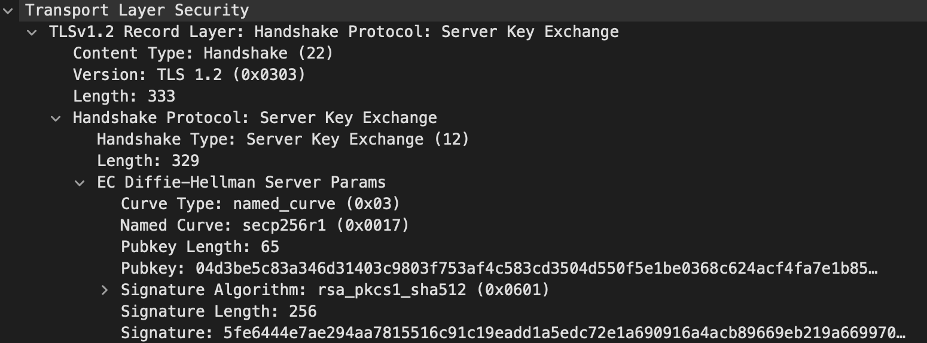
4. Server Key Exchange
The server sends ECDHE material to the client
ECDHE public value (pubkey) is signed by the RSA private key
The public key is available in the certificate

Slide 36
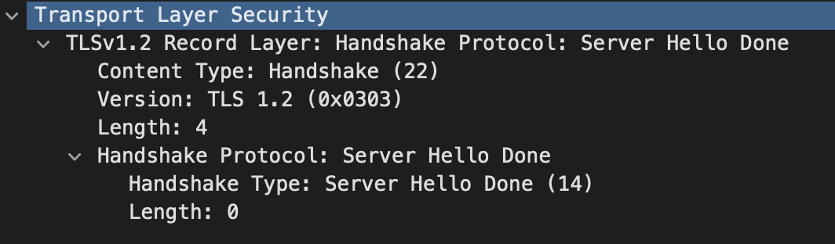
5. Server Hello Done
Indicating that the server has finished sending required values to the client…

Slide 37
SSL/TLS Steps
Client
1. Client hello
Server
2. Server hello
3. Server Certificate
4. Server Key Exchange
Shares DH material, signed by the public key
5. Server Hello Done
Now, a client can
Verify server signature and
Share a secret via DH!

Slide 38

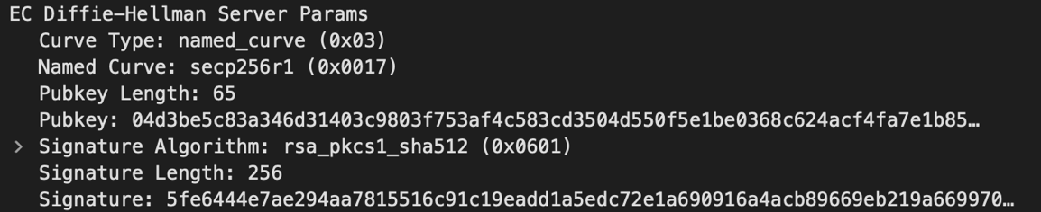
Diffie-Hellman Weakness: Man-in-the-middle Attack
Suppose C intercepts communication between A and B
A chooses a = 4
A = 5⁴ mod 23 = 625 mod 23 = 4
B chooses b = 3
B = 5³ mod 23 = 125 mod 23 = 10
C chooses c = 5
C = 55 mod 23 = 3125 mod 23 = 20
C sends 20 to both A and B
4
20
20
10

Slide 39
SSL/TLS Steps
Client
1. Client hello
6. Client Key Exchange
Shares DH material after verifying server signature for server’s DH material
7. Change Cipher Spec
8. Encrypted Handshake Message
Server
2. Server hello
3. Server Certificate
4. Server Key Exchange
Shares DH material, signed by the public key
5. Server Hello Done

Slide 40
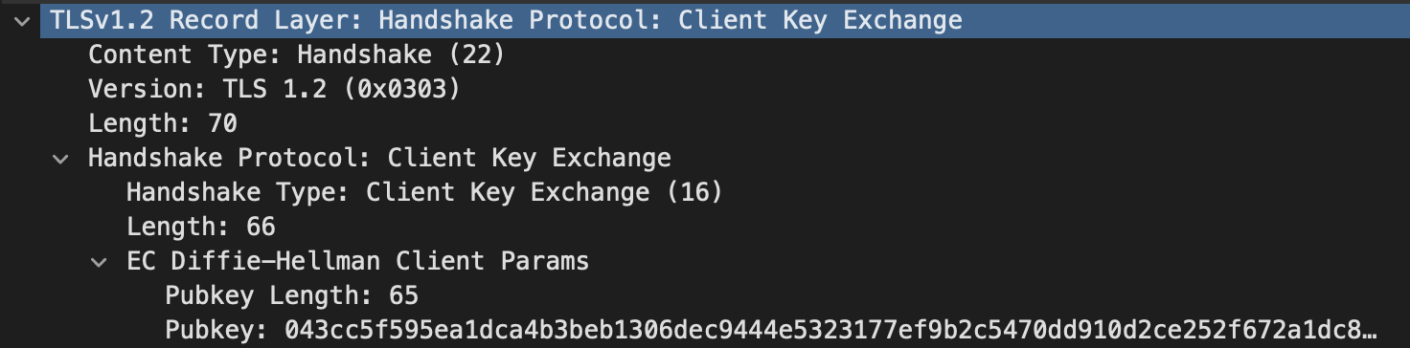
6. Client Key Exchange
The client also shares ECDHE material to the server
After doing this, two will share a secret
We will generate encryption and MAC key by using the shared secret
The client and the server will share a secret after sending this message because
Server sent ‘b’ at the step 5. Server Key Exchange

Slide 41
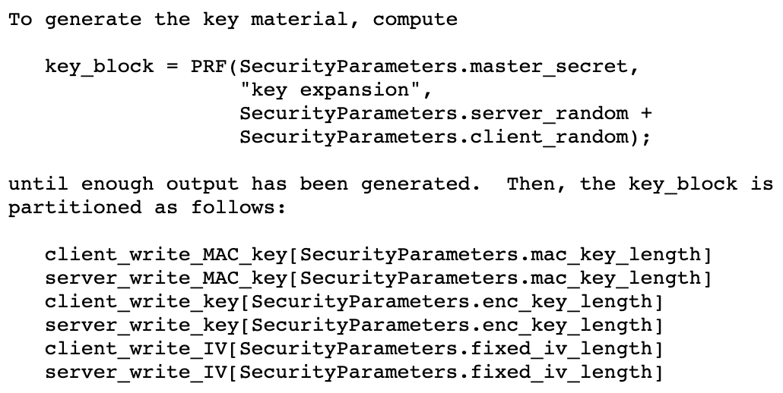
6-1. Client Generates Session Keys
Now the client knows both ‘a’ and ‘b’ of ECDHE key exchange
That is, the client knows the shared secret
Then, the client computes the following keys from the shared secret
These are from
Client Hello and
Server Hello

Slide 42
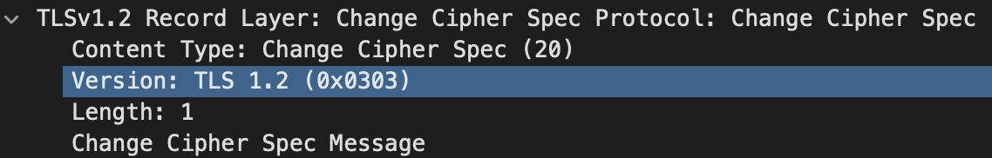
7. Change Cipher Spec (client)
The client lets the server know that we will use encrypted communication after this message…
Now I have keys to encrypting data and generating MACs.
Therefore, the server, “let’s communicate securely”!

Slide 43
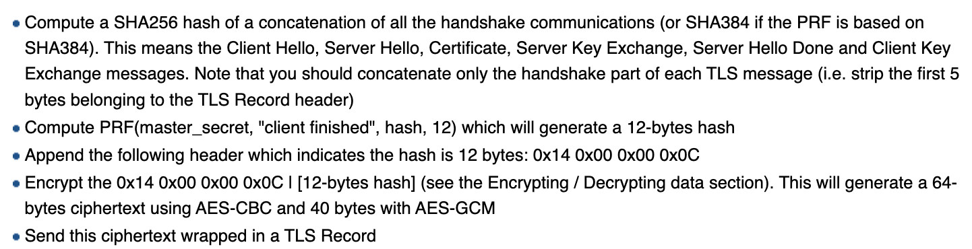
8. Encrypted Handshake Message
Encrypted data of previous messages…
Purpose: Let the server verify if the client generated keys correctly

Slide 44
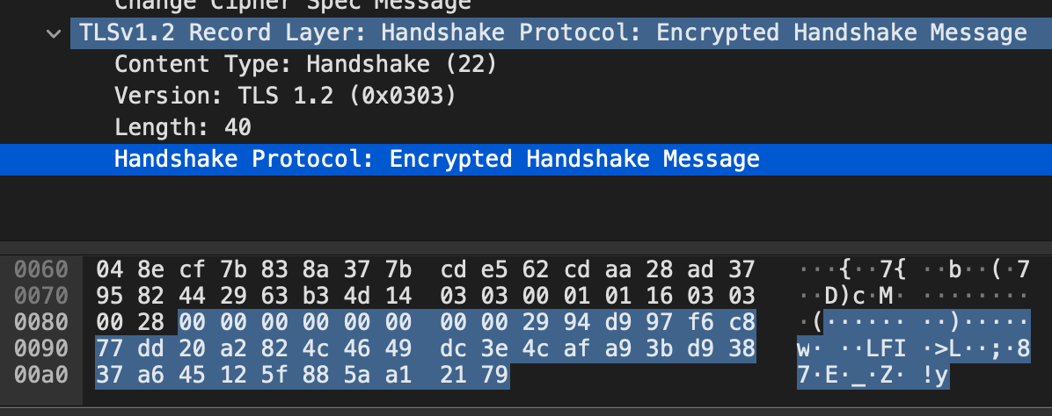
8. Encrypted Handshake Message
Encrypted data of previous messages…
Purpose: Let the server verify if the client generated keys correctly

Slide 45
SSL/TLS Steps
Client
1. Client hello
6. Client Key Exchange
Shares DH material after verifying server signature for server’s DH material
7. Change Cipher Spec
8. Encrypted Handshake Message
Server
2. Server hello
3. Server Certificate
4. Server Key Exchange
5. Server Hello Done
9. Change Cipher Spec
10. Encrypted Handshake Message

Slide 46
9-0. Check Client’s Encrypted Handshake Message
Server verifies client’s encrypted handshake message first
After generating client_write_key
Decrypt the message
Compute the same value
Compare!

Slide 47
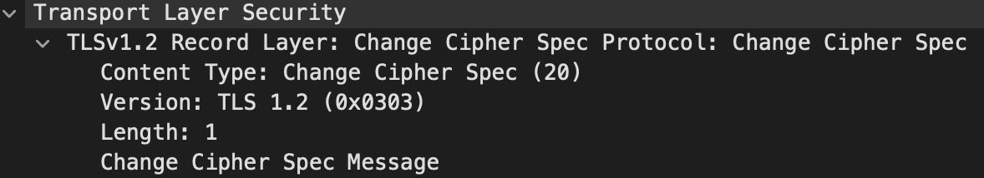
9. Change Cipher Spec (Server)
The server lets the client know that we will use encrypted communication after this message…
Now I have keys to encrypting data and generating MACs.
Therefore, the server, “let’s communicate securely”!

Slide 48
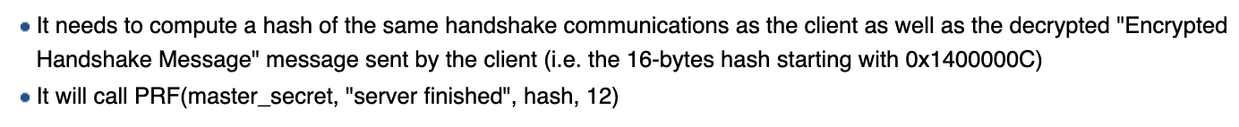
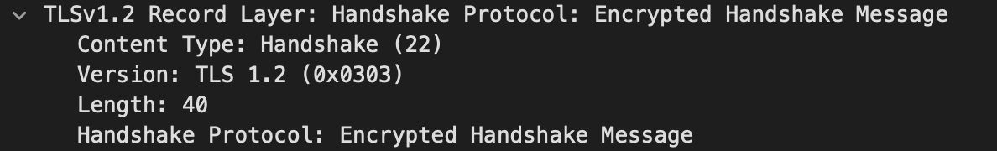
10. Encrypted Handshake Message
Encrypted data of previous messages…
Purpose: Let the client verify if the server generated keys correctly

Slide 49
11. Application Data
Server/Client will send encrypted data to the client
Both always sends [ encrypted data ] [ MAC ]
Server will use server_write_key and server_write_mac_key
Client will use client_write_key and client_write_mac_key

Slide 50
ECDHE-RSA-AES-128-GCM-SHA256
ECDHE
Key exchange algorithm. Elliptic Curve Diffie—Hellman Ephemeral
RSA
Digital Signature algorithm. We use this for checking authenticity
AES-128-GCM
Symmetric cipher algorithm/mode. We will use AES-128 in GCM mode
SHA256
HMAC algorithm. We will use SHA256 to construct an HMAC

Slide 51
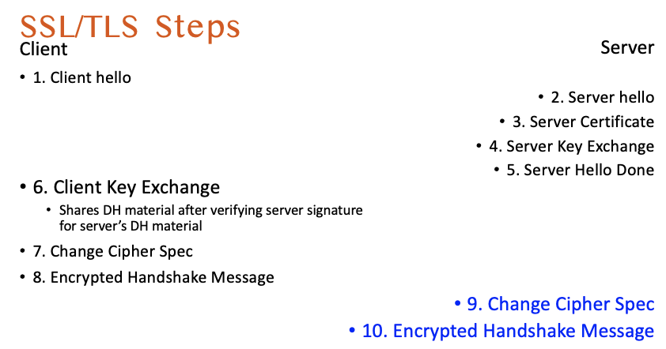
Why no Man-in-the-middle?
Client verifies server’s certificate sent at step 3
Client verifies server’s key material using the public key in the cert
Certificate guarantees the authenticity of
Server domain name (e.g., google.com)
Server’s DH key material
This means, if DH exchange was done,
Only the server knows the shared secret
Except the client itself..

Slide 52
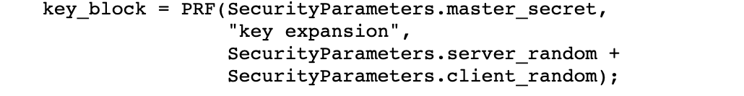
Can we guess the key?
Key generation is designed to make guessing the key difficult
Server chooses their own random
Client chooses their own random
Shared secret is naturally looks like a random number (DH)
PRF, we use either SHA256 or SHA384… good luck, hackers..

Slide 53
Why we hash all the previous messages??
Verification of the final hash means
Server/Client sent/received the same messages
Server/Client have generated the same shared secret (via DH)
Server/Client have generated the same set of encryption/MAC keys

Slide 54
How Do We USE SSL/TLS?
HTTP(s)
Hypertext Transfer Protocol
A network protocol for accessing World Wide Web
http:// vs. https://
http:// ← this directive let web browsers connect directly via HTTP
https:// ← this directive let web browsers connect HTTP via TLS
How?

Slide 55


A Web Server Example
HTTP
Directly talks HTTP

Slide 56
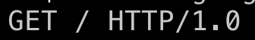
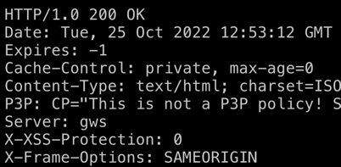
A Web Server Example
This is how HTTP works

Slide 57
A Web Server Example
HTTPS
TLS
TLS
Insecure Internet

Slide 58
A Web Server Example
Run TLS handshake to establish a secure channel

Slide 59
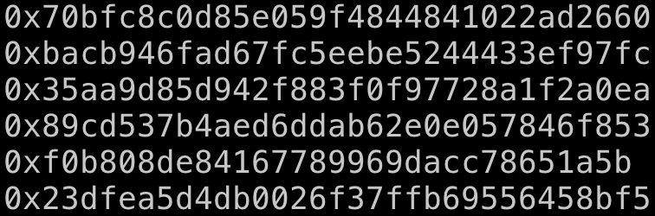
A Web Server Example
TLS
TLS
Insecure Internet

Slide 60
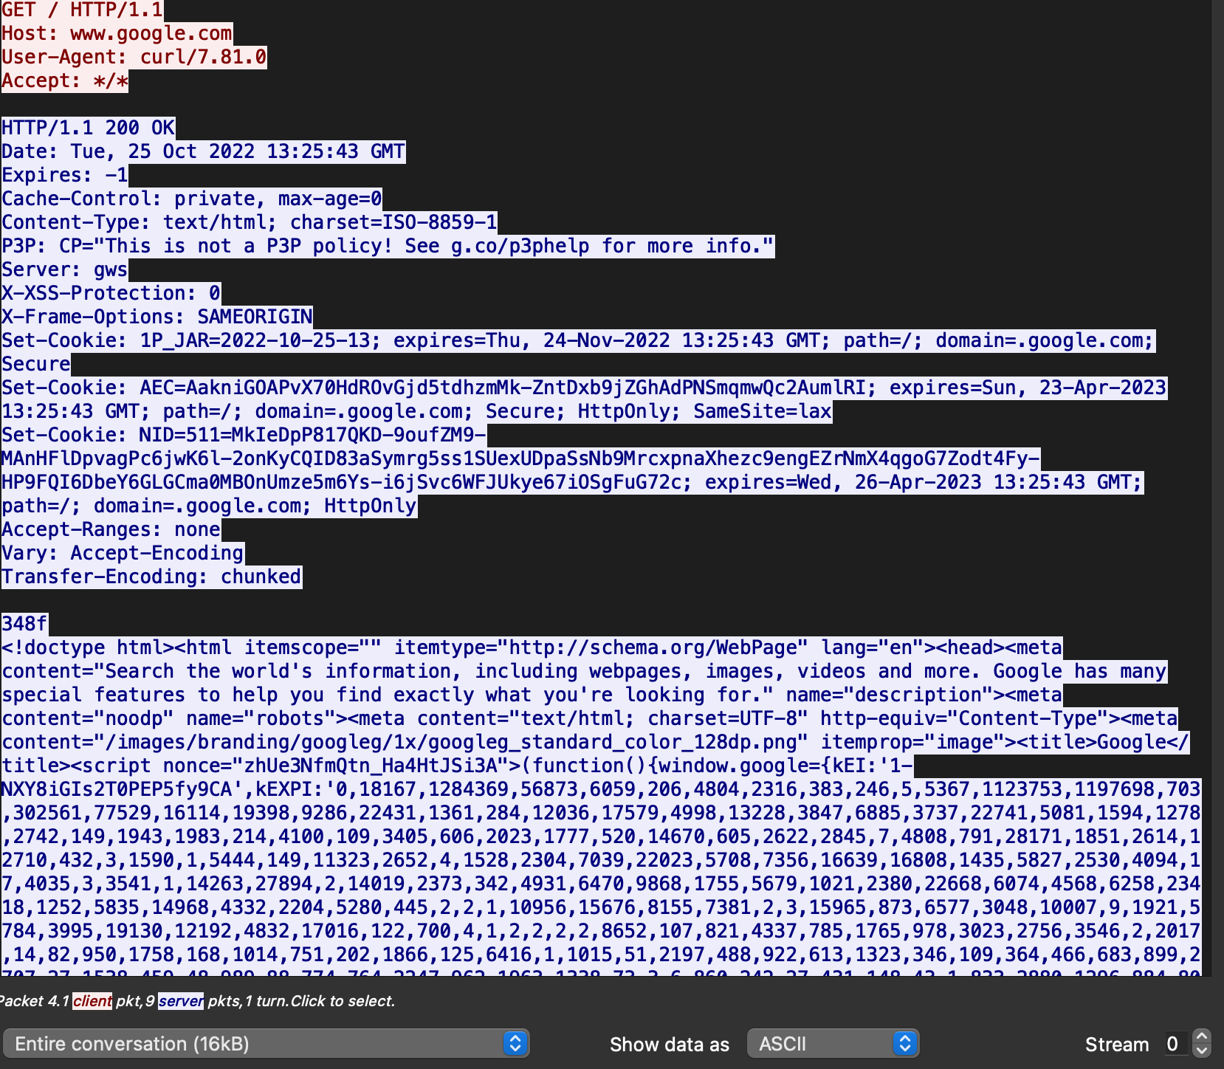
HTTP Packets

Slide 61
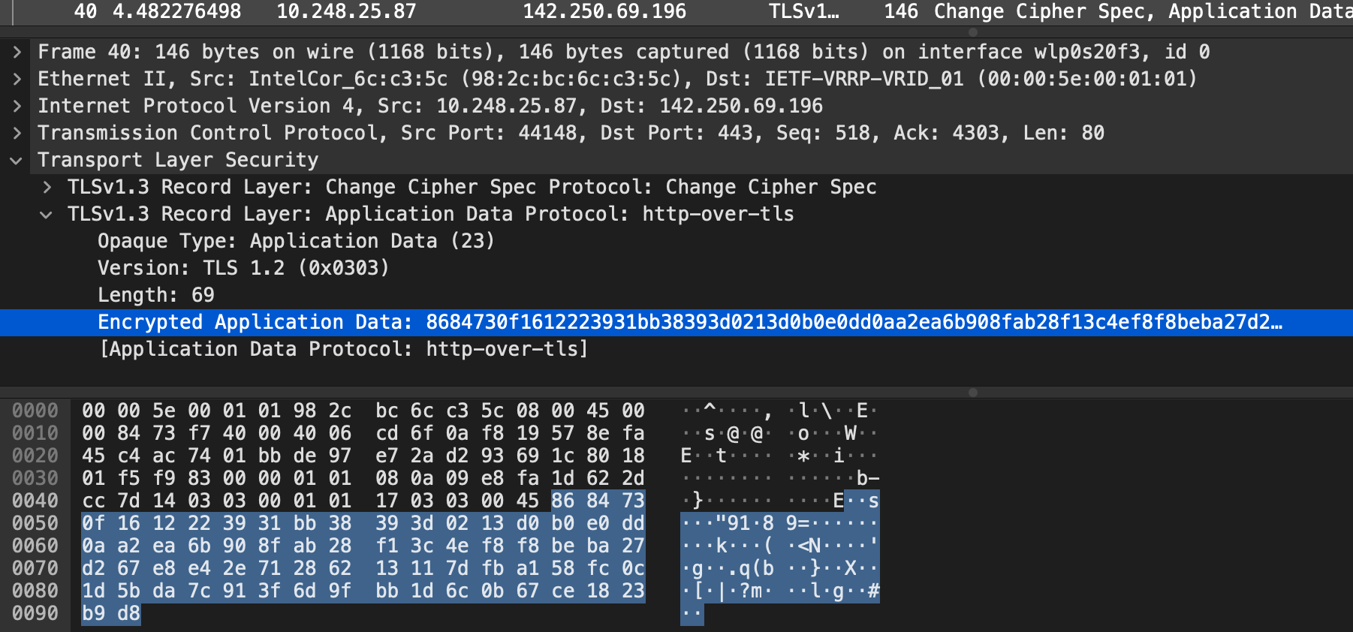
HTTPS Packets

Slide 62
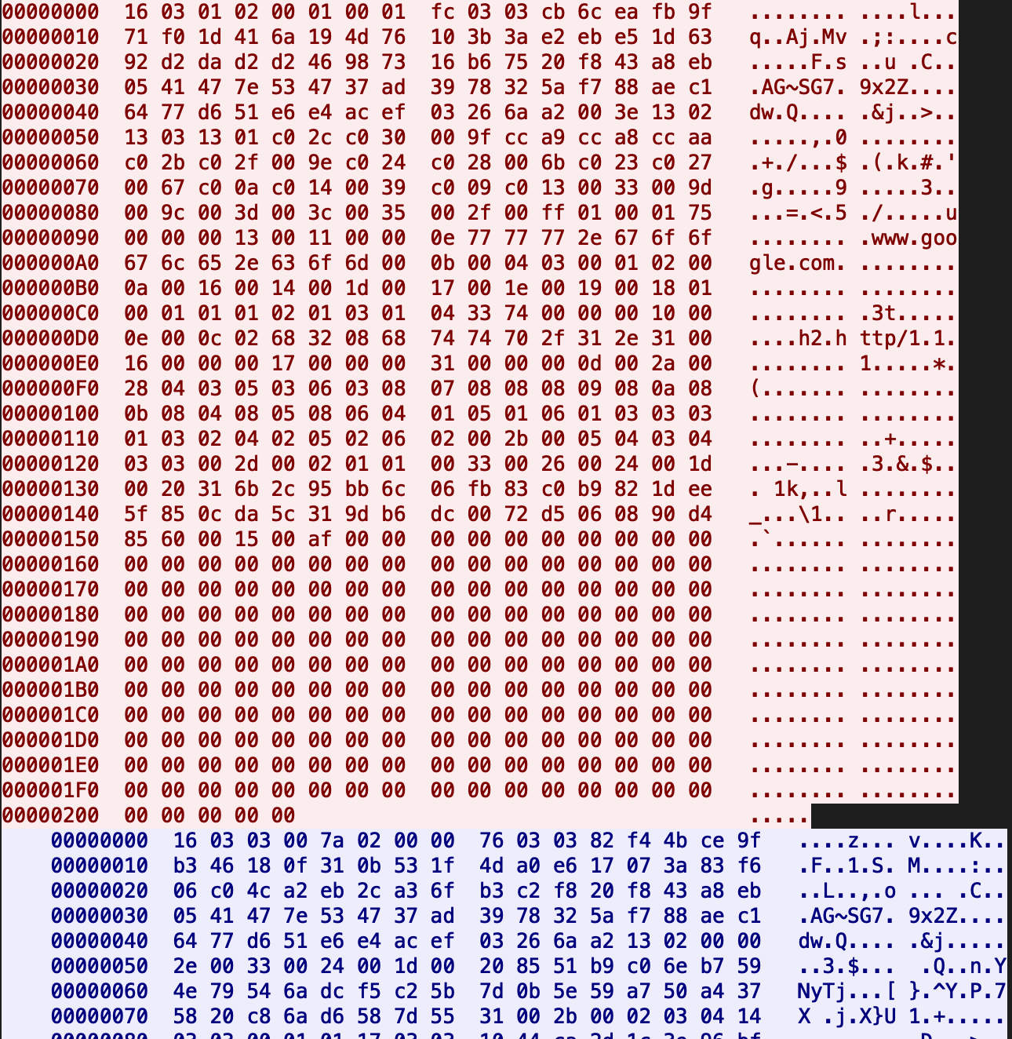
HTTPS Packets

Slide 63
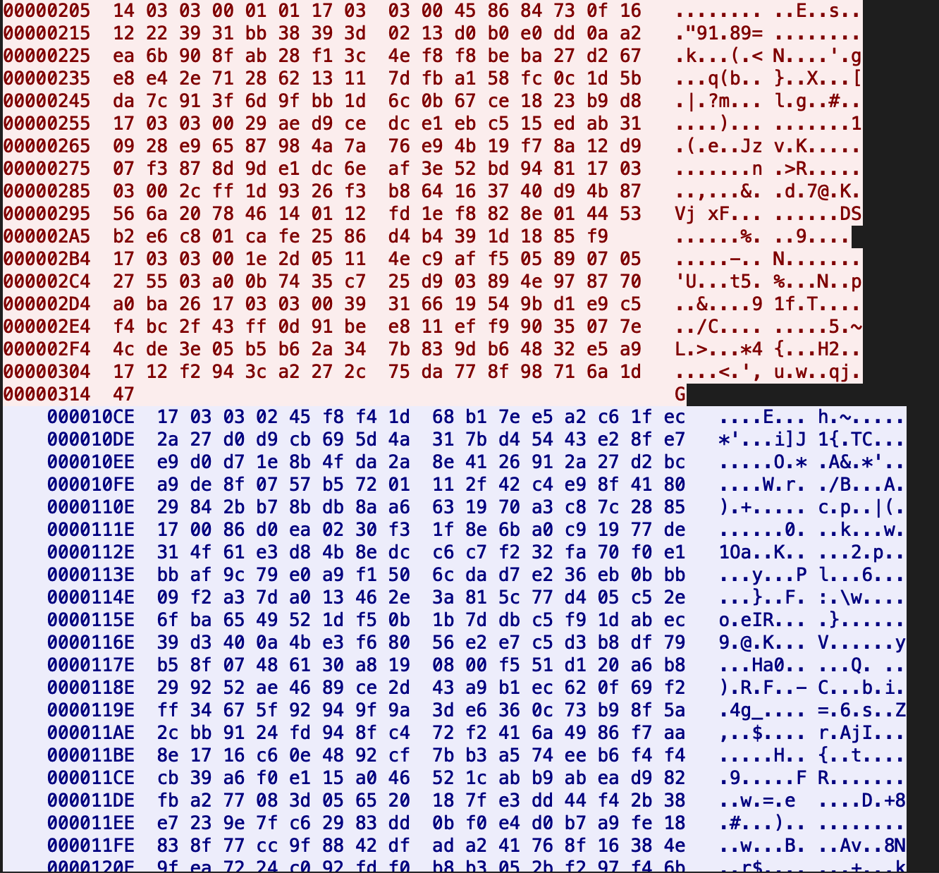
HTTPS Packets

Slide 64
Why TLS is good?
TLS establishes a secure communication channel
Over the insecure Internet
Adds authenticity, confidentiality, and integrity to the channel
Applications don’t have to change their protocol
Just wrap the protocol with TLS
How can we make HTTP secure?
Wrap with TLS: https://...

Slide 65
How Can We Use TLS?
Many libraries are available
OpenSSL
libsodium
bouncycastle
SSL/TLS support in many other languages (Python, etc.)
Just wrap with this
What does it mean???

Slide 66
A Python Example
Suppose you have a protocol that
1) You need to send ‘Hello’ to the server
2) You need to receive a number from the server
3) You need to add 1 to the number and send back to the server
Let’s write programs (server/client) for it.

Slide 67
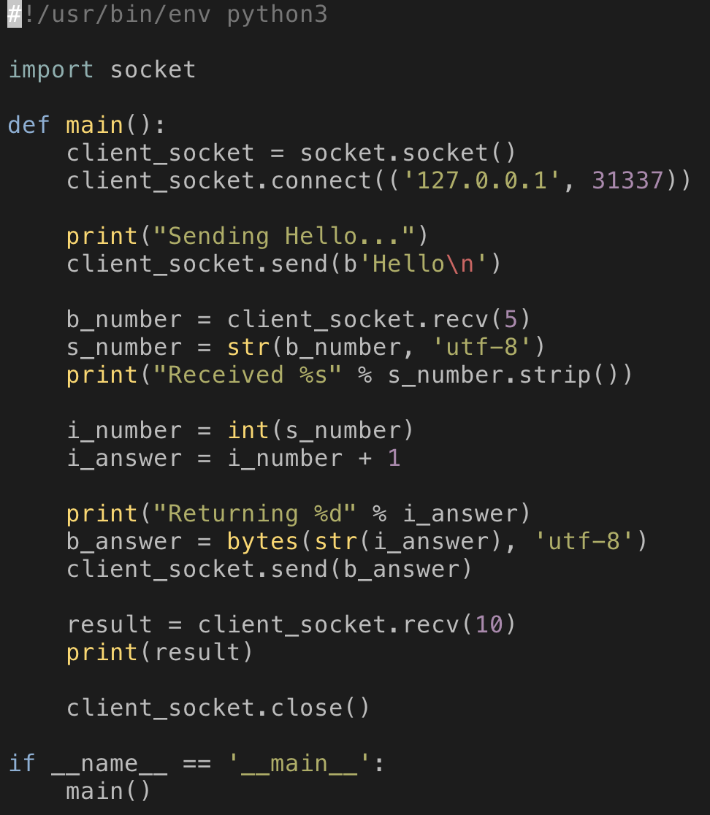
Non-TLS Client
The protocol
1) You need to send ‘Hello’ to the server
2) You need to receive a number from the server
3) You need to add 1 to the number and send back to the server

Slide 68
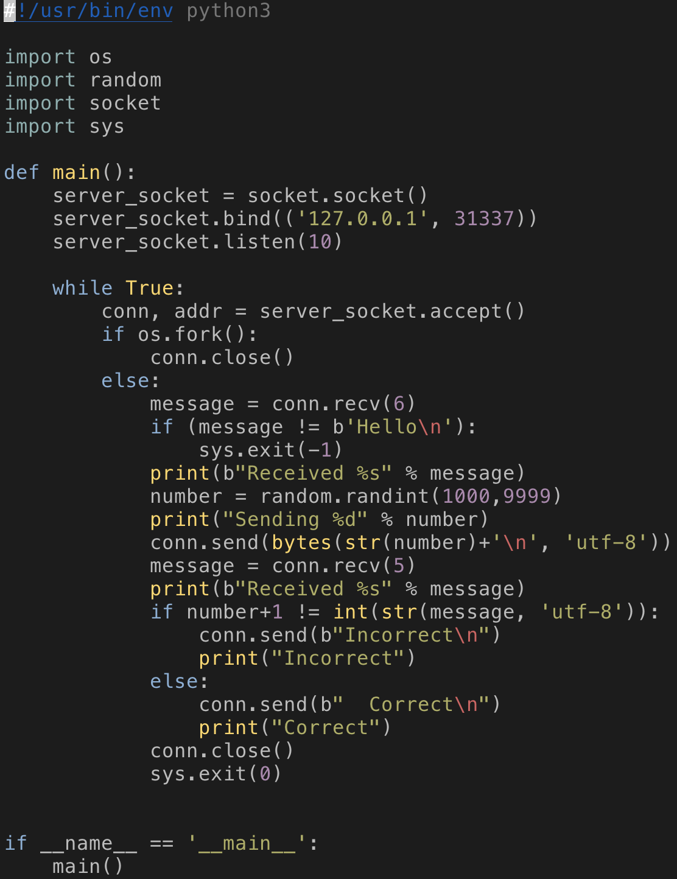
Non-TLS Server
The protocol
1) You need to send ‘Hello’ to the server
2) You need to receive a number from the server
3) You need to add 1 to the number and send back to the server

Slide 69
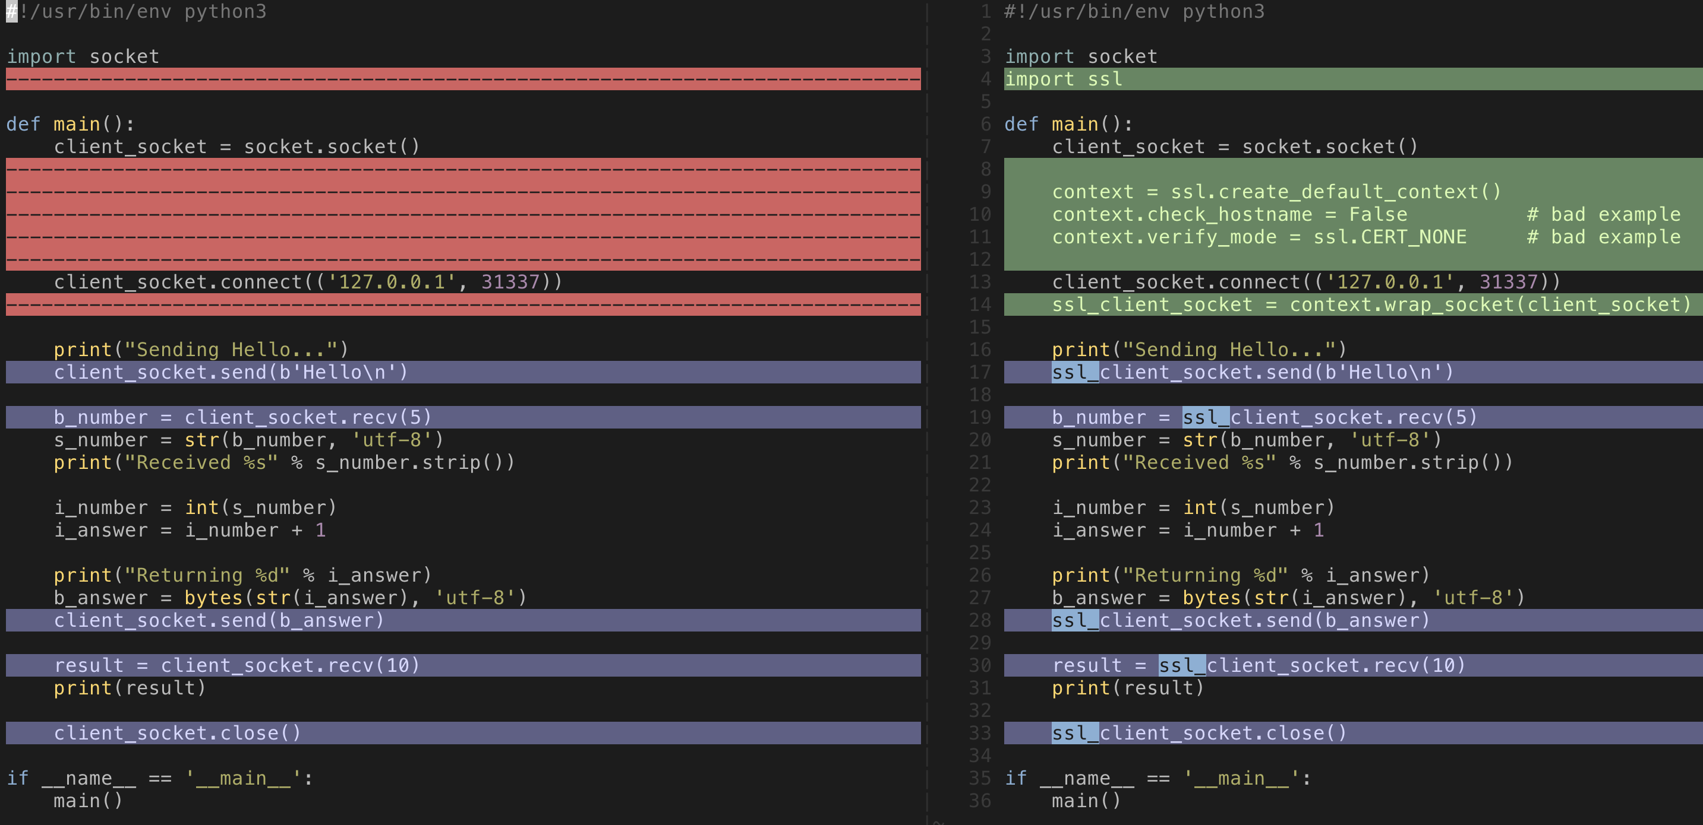
Diff: Non-TLS vs TLS Client

Slide 70
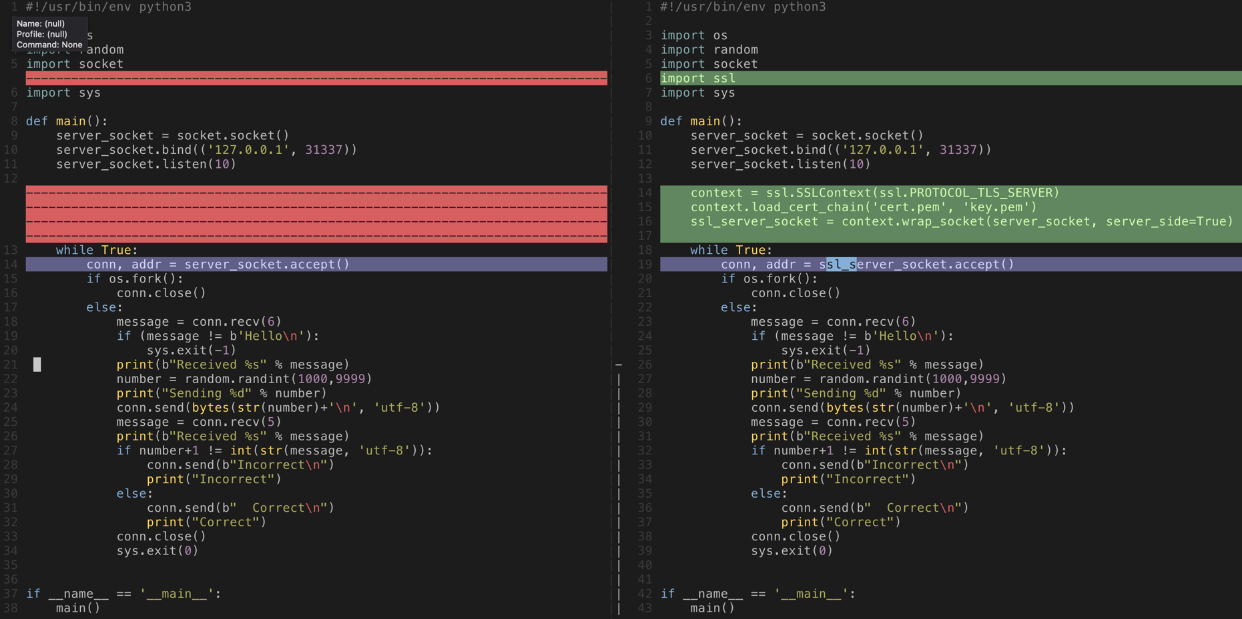
Diff: Non-TLS vs TLS Server

Slide 71
Summary
The Internet is insecure by default
TLS provides a transparent way to establish a secure communication channel and use it
TLS handshake uses digital signature (RSA), key-exchange algorithm (ECDHE), symmetric cipher (AES-128-GCM) and HMAC (SHA256)
Provides authenticity, confidentiality, and integrity to the channel
Applications can enjoy the added security by just wrapping sockets
Only for TCP applications
DTLS is for UDP communications

